Slide 1

Sequential Circuit Model
CSE 4205 Digital Logic Design
Course Teacher: Md. Hamjajul Ashmafee
Lecturer, CSE, IUT
Email: ashmafee@iut-dhaka.edu

Slide 2
Remaining to Add
Review other books and internet resources
Mealy and Moore FSM conversion
Notes:
What is digital computer? Examples where we can use this thing.

Slide 3
Sequential Circuit Model
The present state of the circuit is stored in the memory element
This memory element can be any device to store enough information to specify the state of the circuit
There are two logic circuits in the SC model:
Next state decoder:
To determine the next state of the circuit using the present state and the current input(s)
This next state will be the present state when the memory elements load them
This process is called state change
Also, this process is clocked in synchronous SC
Output decoder:
To determine the output of the circuit using the present state and the current input(s)
This process to generate output(s) is clocked in synchronous SC

Slide 4
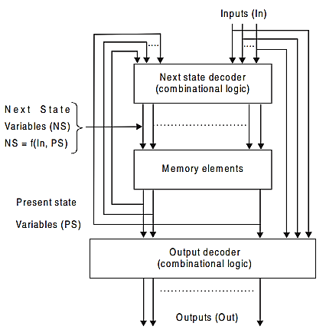
Sequential Circuit Model: Block Diagram

Slide 5
Classification of SC
Generally 5 different classes:
Class A circuits
Class B circuits
Class C circuits
Class D circuits
Class E circuits

Slide 6
Classification of SC: Class A circuits
Defined as Mealy Machine
Named after G.H. Mealy
Basic property:
The output decoder is a function of the present input(s) and the present state(s) of the circuit
The next state decoder is a function of present state(s) and present input(s)

Slide 7
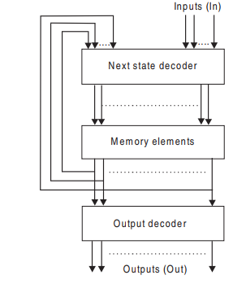
Classification of SC: Class B circuits
Defined as Moore Machine
Named after E.F. Moore
Basic property:
The output decoder is a function of the present state(s) only
It’s a MOORE machine with an output decoder
The next state decoder is a function of present state(s) and present input(s)

Slide 8
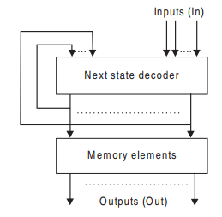
Classification of SC: Class C circuits
Also, defined as Moore Machine
Basic property:
The output decoder is not included in this circuit
It’s a MOORE machine without an output decoder
Contents of memory elements are considered as the output directly
The next state decoder is a function of present state(s) and present input(s)

Slide 9
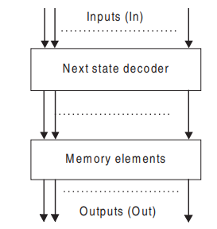
Classification of SC: Class D circuits
Basic property:
The next state decoder is a function of present input(s) only
No output decoder
Contents of memory elements are considered as the output directly

Slide 10
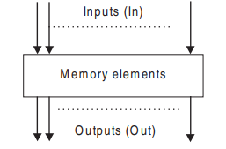
Classification of SC: Class E circuits
Basic property:
The next state decoder is not included in this circuit
Inputs are directly inserted into the memory element
No output decoder
Contents of memory elements are considered as the output directly

Slide 11
State Diagram or State Machine to Represent a Sequential Circuit

Slide 12
State Diagram or State Machine
A transitional diagram from one state to another
Also called as finite automata (or machine)
Alternatively, Finite state machine (FSM)
This topic will also be covered in TOC explained in details
But, here we will explore them in digital logic design, specially in sequential circuit design.
Types of FSM:
Mealy FSM
Moore FSM

Slide 13
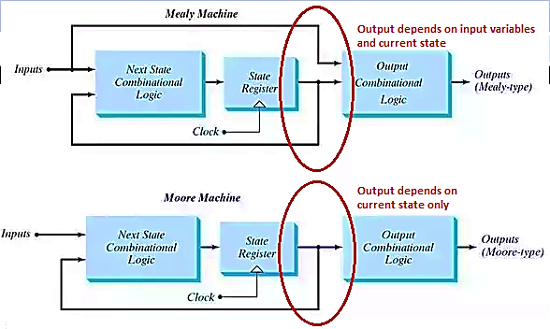
Mealy State Machine
Where output depends on current state and current input
Output is a function of current states and inputs
Basically, asynchronous to input changes
Application: Cipher machine, Vending machine, Traffic light, Bar code scanner

Slide 14
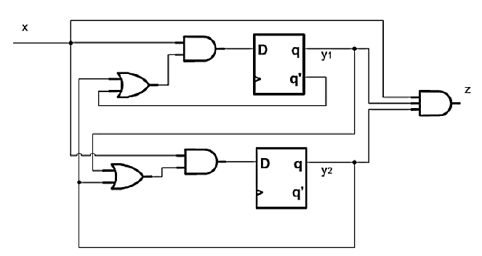
Mealy State Machine: Circuit Diagram Random example

Slide 15
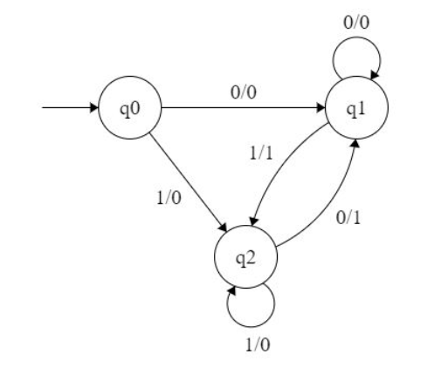
Mealy State Machine: State Diagram Random example
Outputs are represented along with current input(s) separated by /

Slide 16
Moore State Machine
Where output depends on only current state, i.e. output is solely related (paired) to current state.
But, states change based on current input(s) and current state(s)
Output is a function of current states
Basically, synchronous to state changes
Application: Edge detector of clock pulses, Elevator (Loop), Binary adder in FSM, Clocked sequential circuit
Notes:
Edge detector: Detects Rising Edge, Falling Edge, or Either Edge
General Description: The Edge Detector component samples (inspects) the connected signal and produces a pulse when the selected edge occurs.
Usage: Use the Edge Detector when a circuit needs to respond to a state change on a signal.

Slide 17
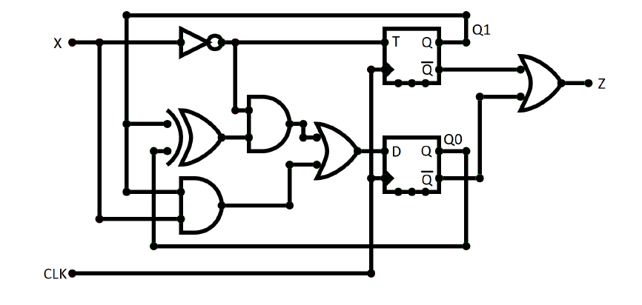
Moore State Machine: Circuit Diagram Random example

Slide 18
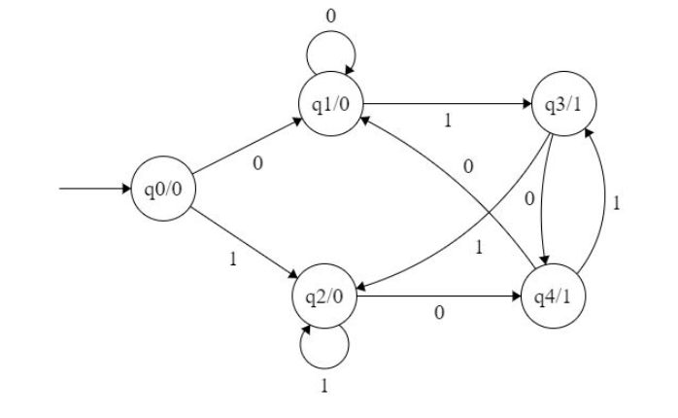
Moore State Machine: State Diagram Random example
Outputs are represented along with current state separated by /
Notes:
Here we can see, the outputs are fixed with current state

Slide 19
Comparison between Mealy and Moore FSM
Mealy FSM tends to have less states
Rather it has different outputs on different arcs than states
Moore FSM is safer to use
In Mealy FSM, if input changes, instantly output will be changed
This kind of problem is basically occurred for asynchronous circuit
Mealy FSM reacts faster to inputs
In same clock cycle, outputs could be changed based on the change of inputs
Sometimes Synchronous (or registered) Mealy FSM could be used to avoid glitchy output
As Mealy FSM considers more information (i.e., inputs) than Moore FSM, it is possible to require one less state than Moore FSM

Slide 20
Mealy and Moore FSM Conversion
Moore to Mealy conversion:
https://www.geeksforgeeks.org/conversion-of-moore-to-mealy-machine-set-4/?ref=rp

